Slide 1
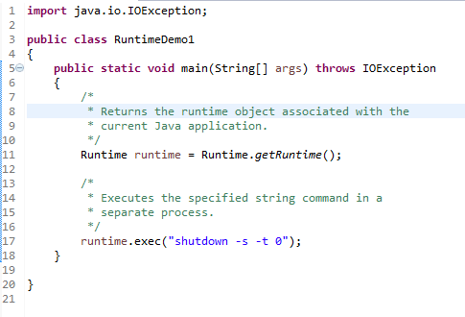
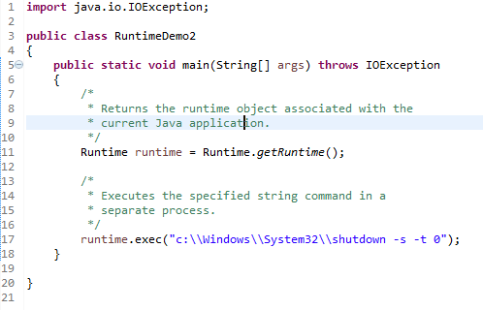
Java Runtime class
We can use shutdown -s command to shutdown system. For windows OS, you need to provide full path of shutdown command e.g. c:\\Windows\\System32\\shutdown.
Here you can use -s switch to shutdown system, -r switch to restart system and -t switch to specify time delay.

Slide 2
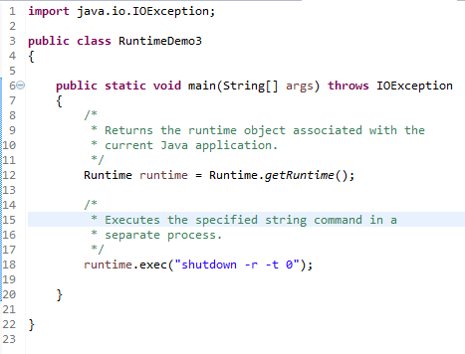
Java Runtime class
We can use shutdown -s command to shutdown system. For windows OS, you need to provide full path of shutdown command e.g. c:\\Windows\\System32\\shutdown.
Here you can use -s switch to shutdown system, -r switch to restart system and -t switch to specify time delay.

